Slide 1
Ms. Garcia

Slide 2
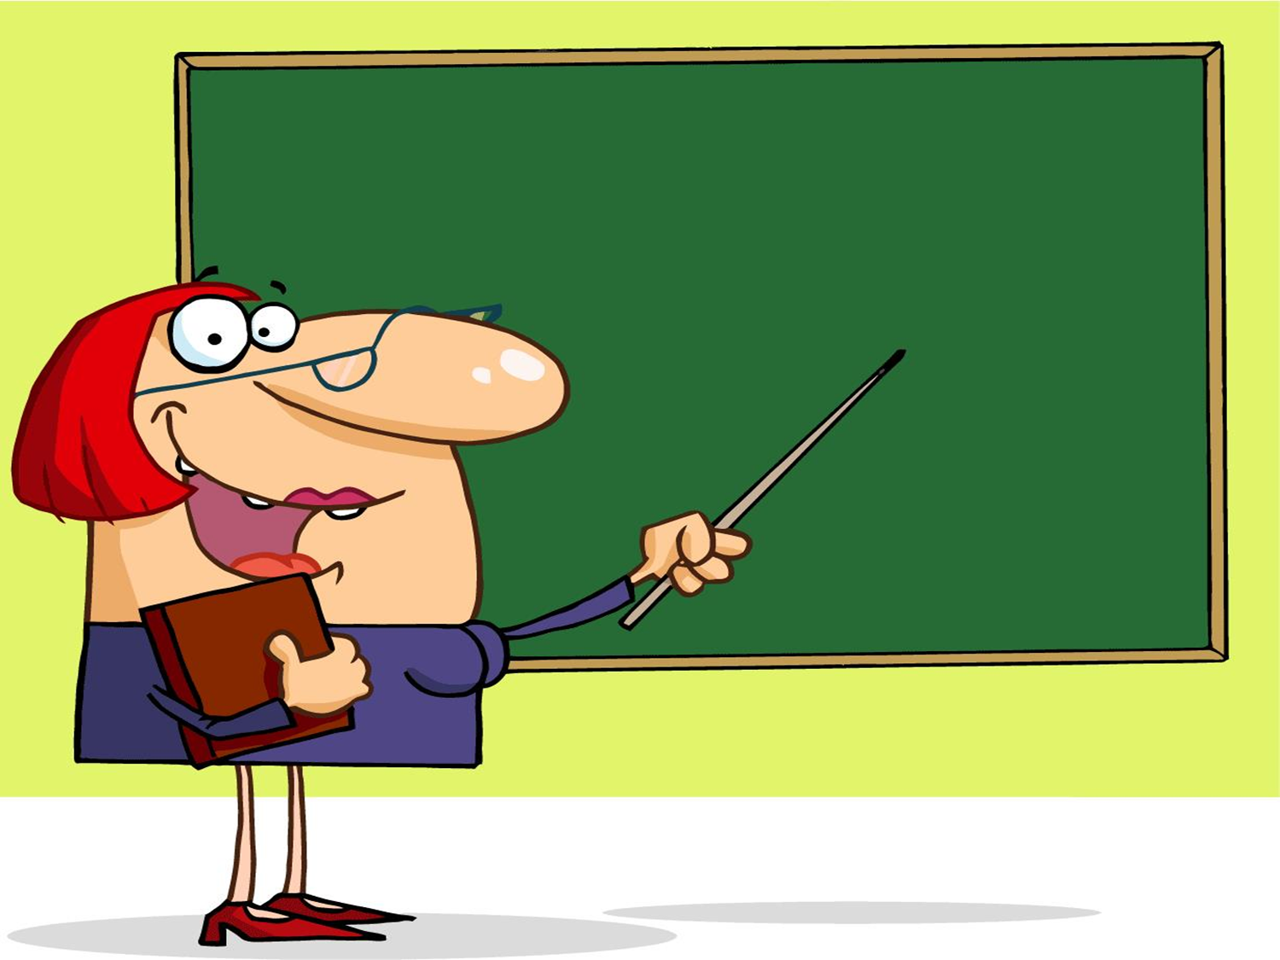
Reading/Language Arts
March 7, 2012
3rd Grade
TODAY’S LESSON IS A CLASSICAL STORY OF

Slide 3
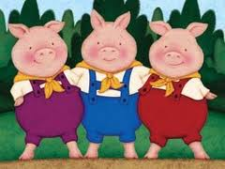
the three little pigs
Link to Fairytale

Slide 4
Students will
identify the
characteristics
of a fable in their favorite reading

Slide 5
The three little pigs leave home.
Bye! Bye!
Go and build your houses
Click on Pig

Slide 6
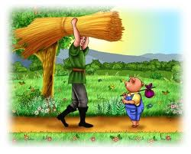
The first pig built his house out of straws.

Slide 7
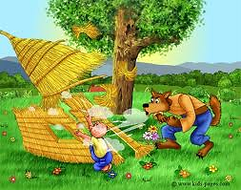
Then I'll huff and I'll puff and I'll blow your house in!
Link to story
Click on the Wolf

Slide 8
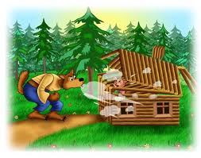
Little pig,
little pig,
let me come in.
The second pig built his house out of wood.
Not by the hair on my chinny-chin-chin!
Click on the wolf

Slide 9
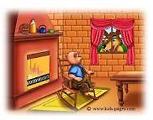
The third pig built his house out of bricks.
Little pig,
little pig,
let me come in.

Slide 10
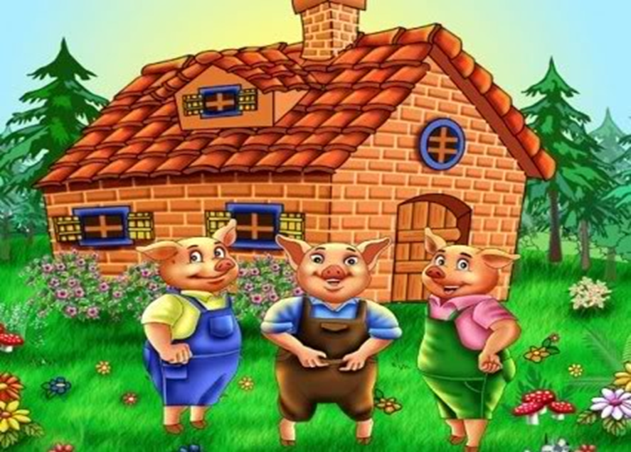
They all live happily ever after in the brick house.
The End.!!

Slide 11
Now it’s your turn to do the following:
Students will be reading stories on fiction and nonfiction.
Students will gather in groups and ask the class monitor to pass the stories and graphic organizers.
Students will then read and discuss the stories in their groups.
Students will complete a graphic organizer.
Students that finish early may look on the white board for additional activities.
Students will be completing a worksheet at the end.

Slide 12
Students will be asked about their experience and what moral issue did they learn.
Students will be reinforced with a five questions worksheet.
Students will participate in creating a skit or play of their story.
Student will be given an overall grade for participation and cooperation of the given material.

Slide 13
Materials & Resources Supplies:
Paper and Pencil
Worksheets
Books
Markers

Slide 14
Technology tools (Software and hardware)
Internet websites
Projector
Poster Board
Chart Paper
Graphic Organizer

Slide 15
OTHER RESOURCES
PBS Kids
Kids Fables
Classical Stories
Children's Classics
Fables
Ms. Garcia Website

